Slide 1
WIND STORM PREDICTION
BY:
G.PRAVEEN KUMAR
CH.BHANU PRAKASH
P.HARISH REDDY
B.JAGADISH

Slide 2
INTRODUCTION Windstorm, a wind that is strong enough to cause at least light damage to trees and buildings and may or may not accompanied by precipitation. Wind speeds during a windstorm typically exceed 55 km (34 miles) per hour. Wind damage can be attributed to gusts (short bursts of high- speed winds) or longer periods of stronger sustained winds. Although tornados and tropical cyclones also produce wind damage, they are usually classified separately.

Slide 3
PROJECT OBJECTIVE
PREDICTING WINDSTORM WITH SPEED AND
ARRIVAL OF TIME.
BY CONSIDERING THE IMPORTANT FACTORS LIKE PREVIOUS DAYS CLIMATE CONDITIONS (TEMPERATURE,PRESSURE)
USING MACHINE LEARNING ALGORITHMS OF
LINEAR REGRESSION
UNIVARIATE
MULTIVARIATE

Slide 4
DATA SET DESCRIPTION
Source dataset is in csv format.
Dataset contains 400 rows and 8 columns
There is no missing values for the provided
input dataset.

Slide 5
EXPLORATORY DATA ANALYSIS
Data visualisation using seaborn and matplotlib
Exploratory data analysis (EDA) is an approach to analyse data sets & to summarize their main characteristics, often with visual methods.
A Statistical model can be used or not, but primarily EDA is for seeing what the data can tell us beyond the formal modelling or hypothesis

Slide 6
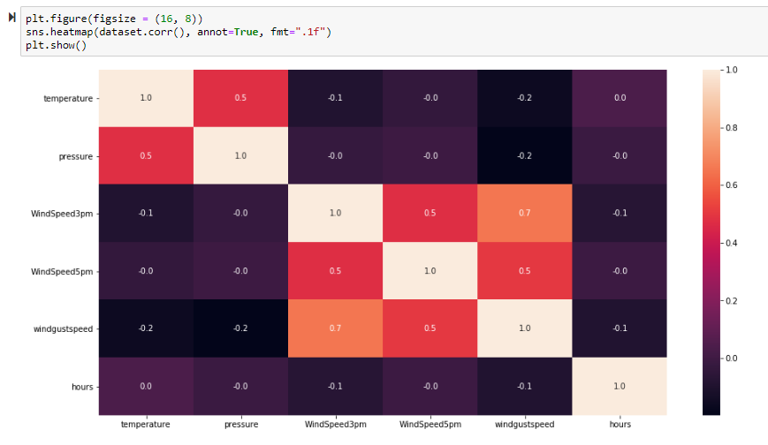
HEATMAP
Based on the Heap map,the factors that impact Wind storm are temperature , pressure.

Slide 7
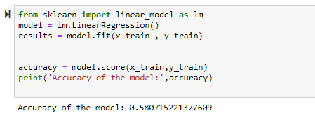
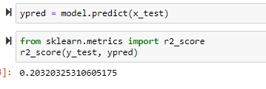
ACCURACY & PERFORMANCE OF THE MODEL
Accuracy
Accuracy of the Univariate Model is 5.6 % .
Accuracy of Multivariate Model is 58.07 %.
Performance
Performance of Univariate Model is 2.6 % which is not acceptable.
Performance of Multivariate Model is 20.3 %.

Slide 8
FINDINGS AND SUGGESTIONS
Rapid Changes in Pressure and Temperature leads to windstrom
If the windgustspeed is between 40 to 60mph there is more probablity of occuring windstrom
Better warn if the wind gust speed in this range
Track the units of all factors which impacts windstorm

